Slide 1
Project Presentation
Name: Pampa Das
Roll: 01-047-07
Batch: 47

Slide 2
Project Title
A study on the correlation between sleep duration, study hours, and academic performance in university students.

Slide 3

Introduction and Background
University students face challenges balancing study, social activities, and well-being.

Slide 4
Objectives
Examine the relationship between sleep duration and academic performance.
Analyze the effect of study quality on performance.
Investigate study hour on performance.

Slide 5
Data Representation
20 students from CSE, STAT, BBA, and LAW departments

Slide 6
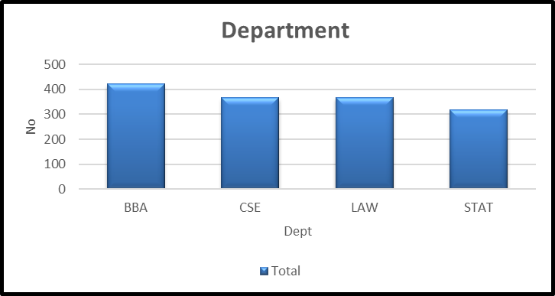
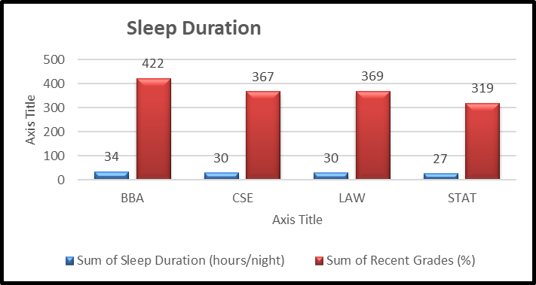
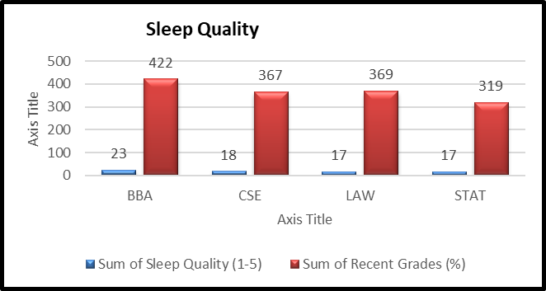
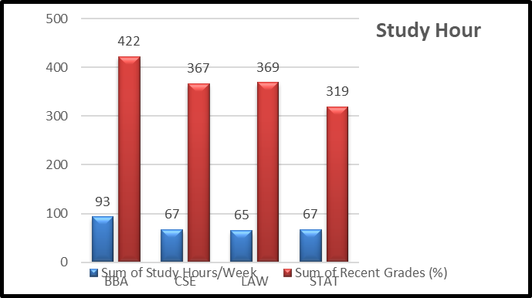
Demographic Data

Slide 7
Analysis (Correlation)
Sleep duration & grades: 0.9499
Sleep quality & grades: 0.8978
Study hours & grades: 0.8606
Findings: Sleep has a stronger impact on grades than study hours.

Slide 8
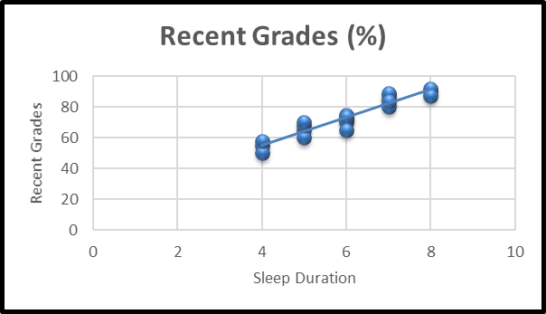
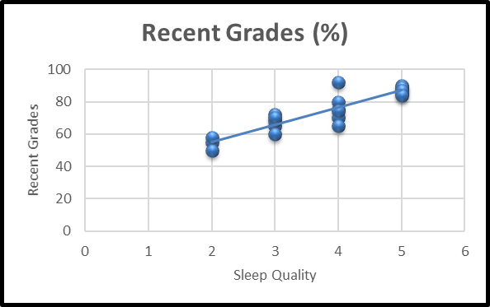
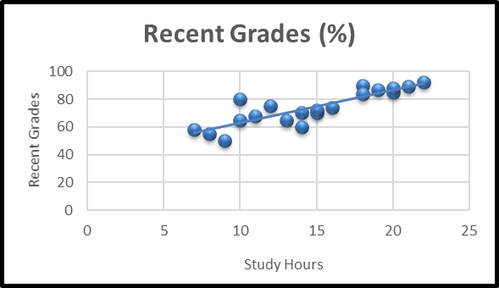
Analysis (Trends)
Recent Grades and Sleep Duration
Recent Grades and Sleep Quality
Recent Grades and Study Hours/Week

Slide 9
Result and Conclusion
Students with longer and high-quality sleep achieve better grades.
Prioritizing adequate sleep.
Effective study routines.

Slide 10
Anything to Ask?

Slide 11
Thank You!

